Slide 1
Java Annotations
In its simplest form, an annotation looks like below.
The at sign character (@) indicates to the compiler that what follows is an annotation.
@Entity
@Override
void mySuperMethod()
{
...
}
In this example, the annotation's name is Override

Slide 2
Java Annotations
@Author(name = “Peter", date = "3/27/2017")
class MyClass()
{
...
}
The annotation can include elements, which can be named or unnamed, and there are values for those elements:
The annotation can include elements, which can be named or unnamed, and there are values for those elements.
If there is just one element named value, then the name can be omitted.
If the annotation has no elements, then the parentheses can be omitted, as shown in the previous @Override example.
@SuppressWarnings(value = "unchecked")
void myMethod() { ... }
@SuppressWarnings("unchecked")
void myMethod() { ... }

Slide 3
Java Annotations
@Author(name = "Jane Doe") @EBook
class MyClass
{
...
}
It is also possible to use multiple annotations on the same declaration.

Slide 4
Java Annotations
If the annotations have the same type, then this is called a repeating annotation.
Repeating annotations are supported as of the Java SE 8 release.
@Author(name = "Jane Doe") @Author(name = "John Smith") class MyClass
{
...
}
Override and SuppressWarnings are predefined Java annotations. It is also possible to define your own annotation type. The Author and Ebook annotations in the previous example are custom annotation types.
Annotations can be applied to declarations: declarations of classes, fields, methods, and other program elements.

Slide 5
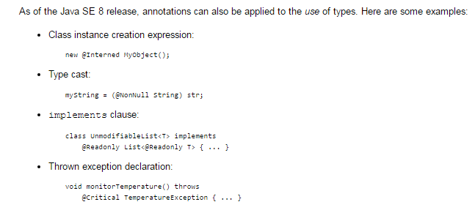
Java Annotations
This form of annotation is called a type annotation

